Slide 1





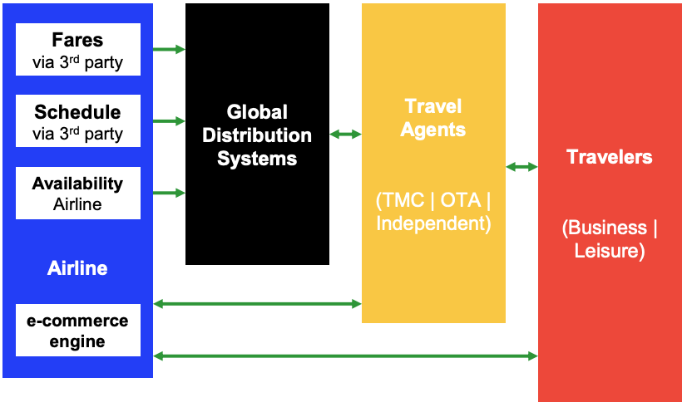
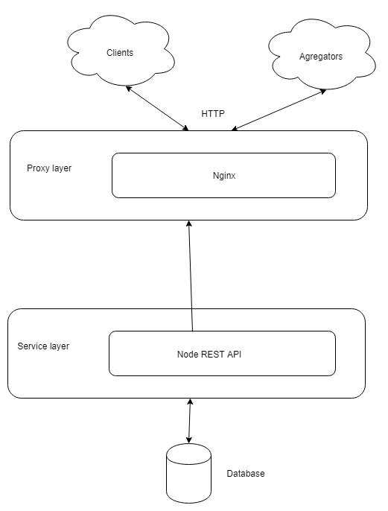
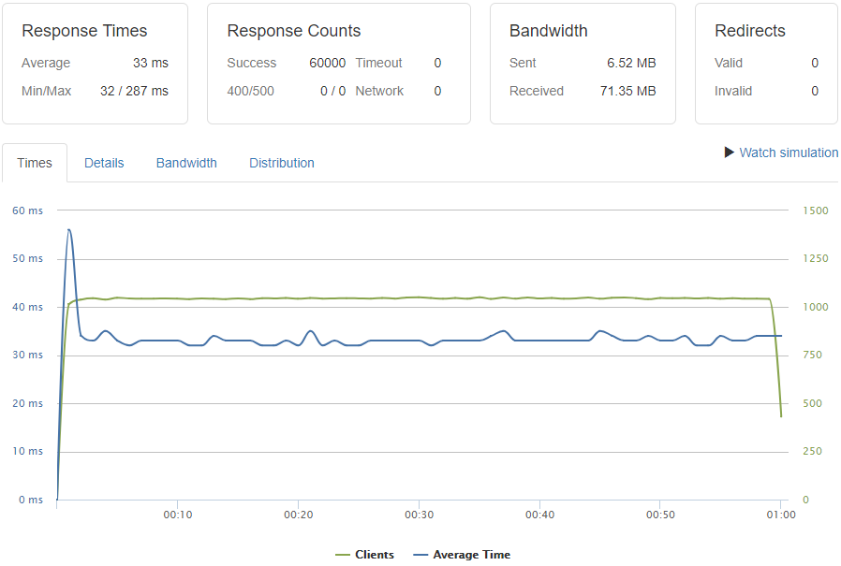
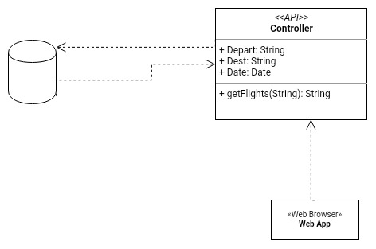
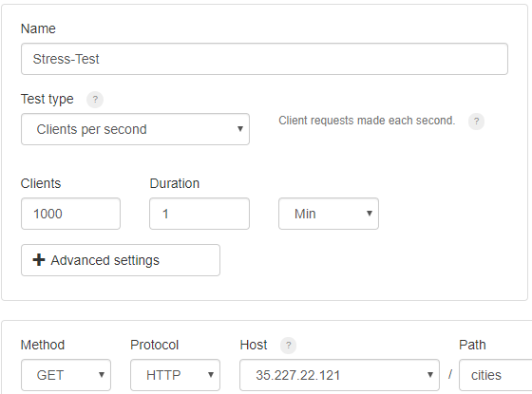
School of Computing & Information Sciences
Spring 2019 Senior Design Project
Next Generation Airline Data Exchange Simulator 1.0
Students: Luis Herrnsdorf
Mentor: The faculty and graduate students at the FIU AIRlab
Instructor: Dr. Masoud Sadjadi, Florida International University
Problem
Customer experience is not consistent depending on where they search for travel.
Travel agencies can’t easily access many airline products that are available.
Airlines don’t have the freedom to distribute their products across channels.
Current System
Requirements
Develop an open source web-based live simulator.
Build a primitive OTA and set up an NDC connection between a simulated travel agent and an airline.
Generate the synthetic data necessary to display in the primitive OTA.
System Design
Screenshots
Object Design
Verification
Test case ID: ApiDbPerformance.
Description/Summary of test: As a system architect I want my airline database to perform well with around 600 transactions per second of reads.
Preconditions: PostgreSQL DB is up and contains data. API service is up and waiting for requests.
Expected result: Debian servers on Google Compute Engine.
Actual result:System performed better than expected at 1000 requests/sec.
Status (Fail/Pass): Pass
Implementation
Rest API developed with ExpressJs Framework.
Nginx reverse proxy.
PostgreSQL as database.
Debian servers on Google Compute Engine.
Summary
Web app to sell flights to travellers.
Web service that receives and respond to valid NDC requests.
Expose Airline web service to different aggregator services.
Notes:
‹#›

